Slide 1
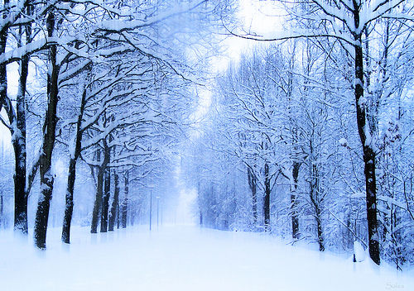
Snow days……
L/Q: what will your memories be?

Slide 2
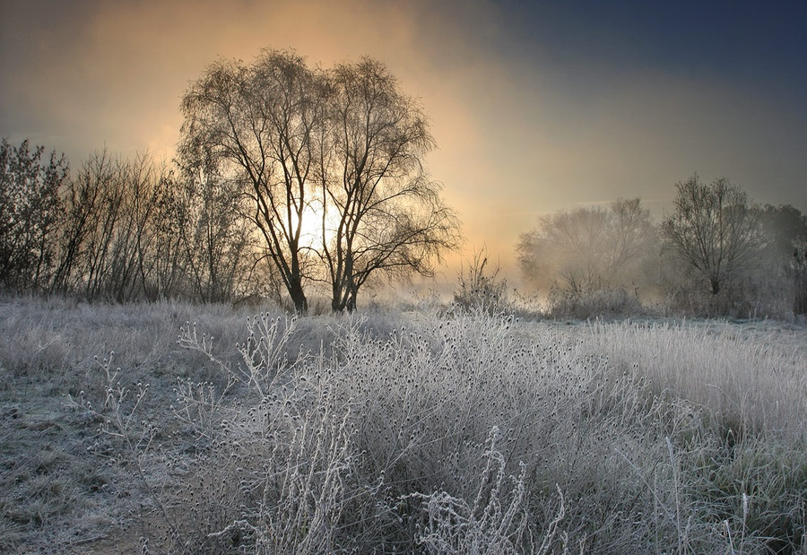
Many of your relatives will remember the winter of 1963….
It was the worst winter in Great Britain of the 20th Century.
The short clip you are about to watch gives a glimpse into the past….

Slide 3
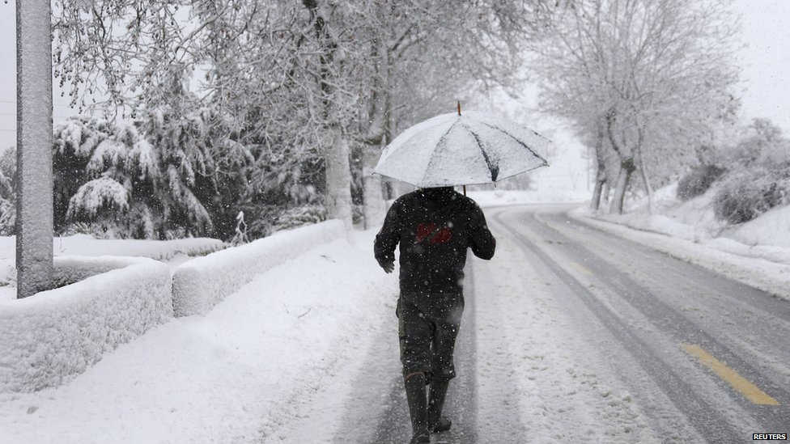
If you were making a similar film today about the recent weather conditions…
What would you include?
Fold your paper into an eight box storyboard.
Under each square, make notes of how you have coped both in school and at home.
Now draw pictures of what shots would you include.

Slide 4
WHY NOT…?
Interview somebody who remembers the winter of 1963 ?
Record it on your phone or take notes
Put together a comparison slideshow ?

Slide 5
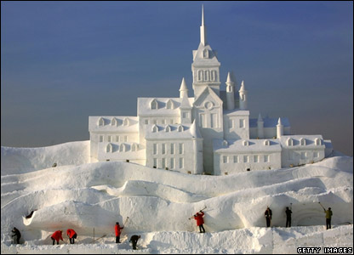
ENJOY THE CLIP ☺

Slide 6
http://www.youtube.com/watch?v=DalYSIRU4rQ

