Slide 1
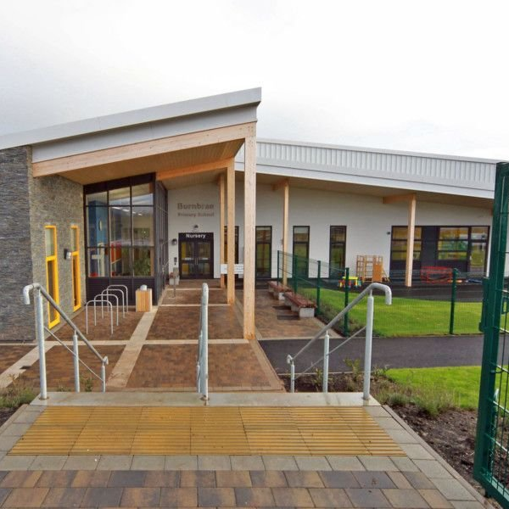
Welcome to Burnbrae Primary School
November 2023

Slide 2
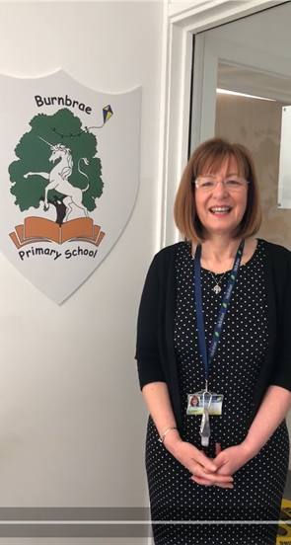
Mrs Linda Clarkson
Head Teacher
It is wonderful to welcome you to Burnbrae Primary School!
We are a large Primary School over two buildings with P1-7 here at Burnbrae Primary on Burnbrae Road. We want you to see the wonderful environment for our P1 pupils and also develop a relationship where you are comfortable to ask questions and let us know information that will help us make a smooth transition for your child or children.
Next week you will enrol your child/ren for P1 and we want you to look forward to and plan for this milestone.

Slide 3
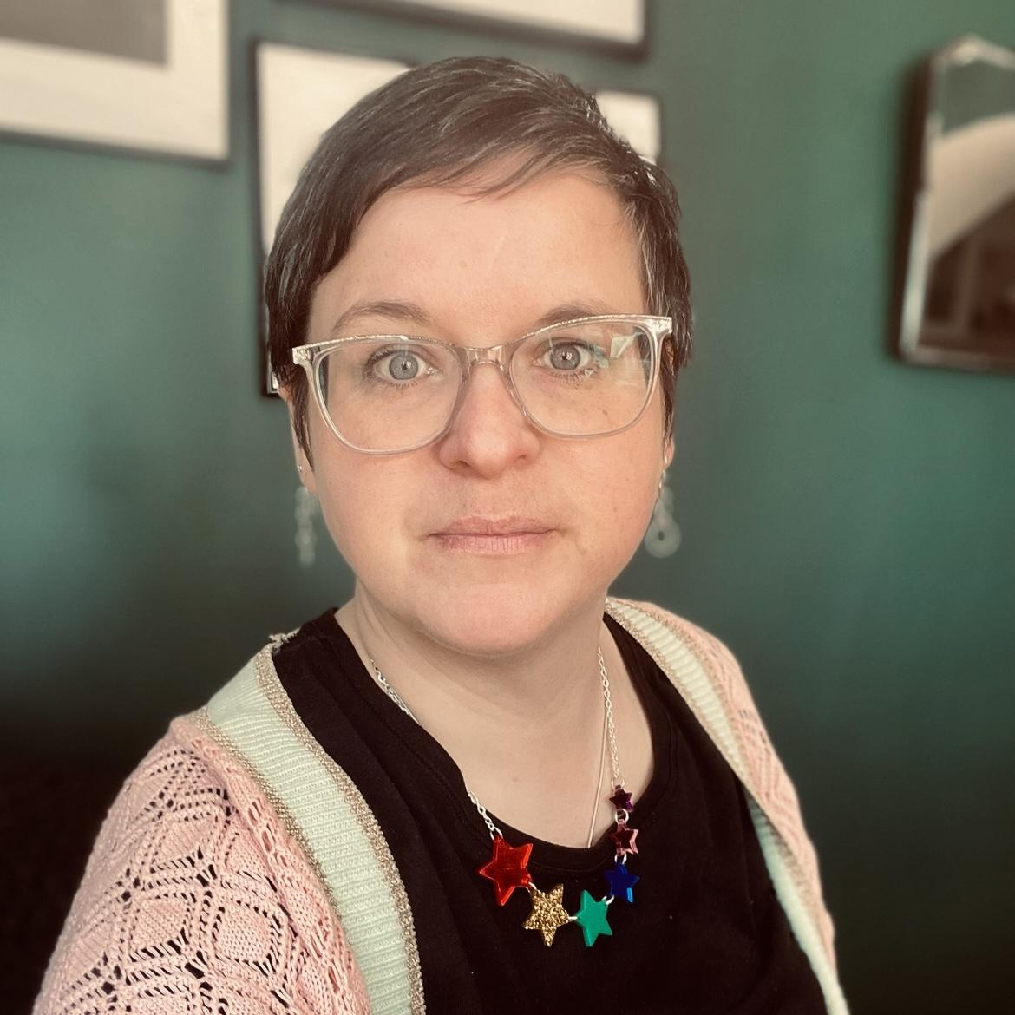
Depute Head Teacher Team
Amy Richmond
Red Atrium P5 -7
Katherine Jamil
Blue Atrium P2-4
Kerry Knight
Burnbrae ELC
The Wee Brae
Primary One

Slide 4
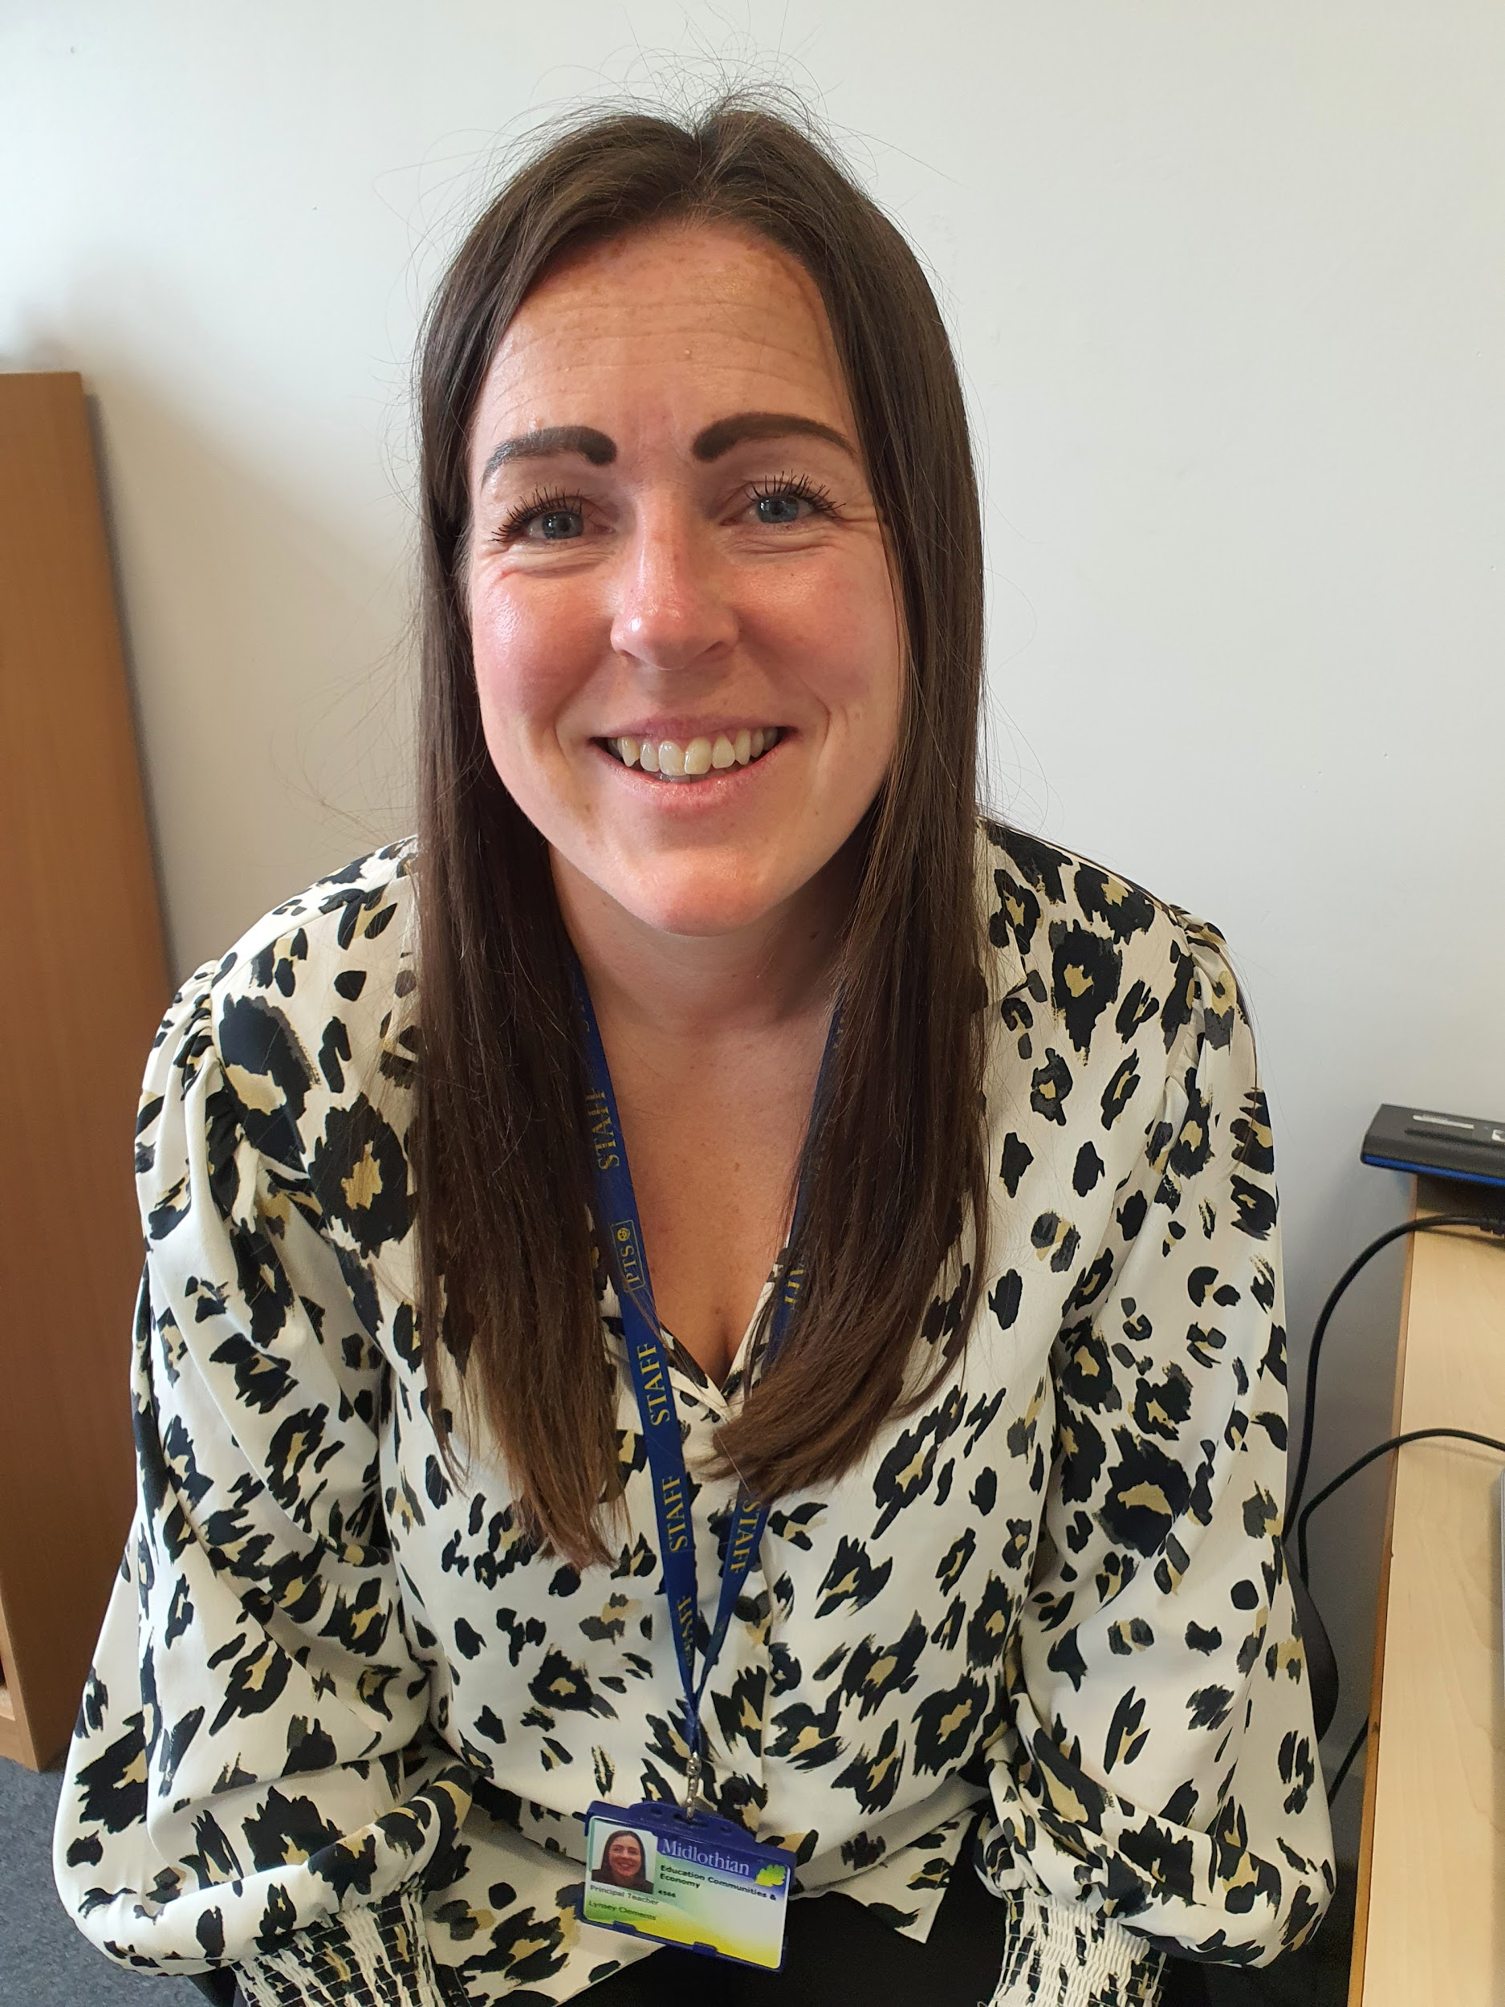
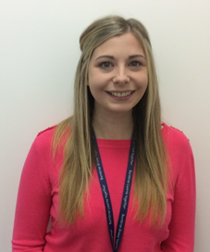
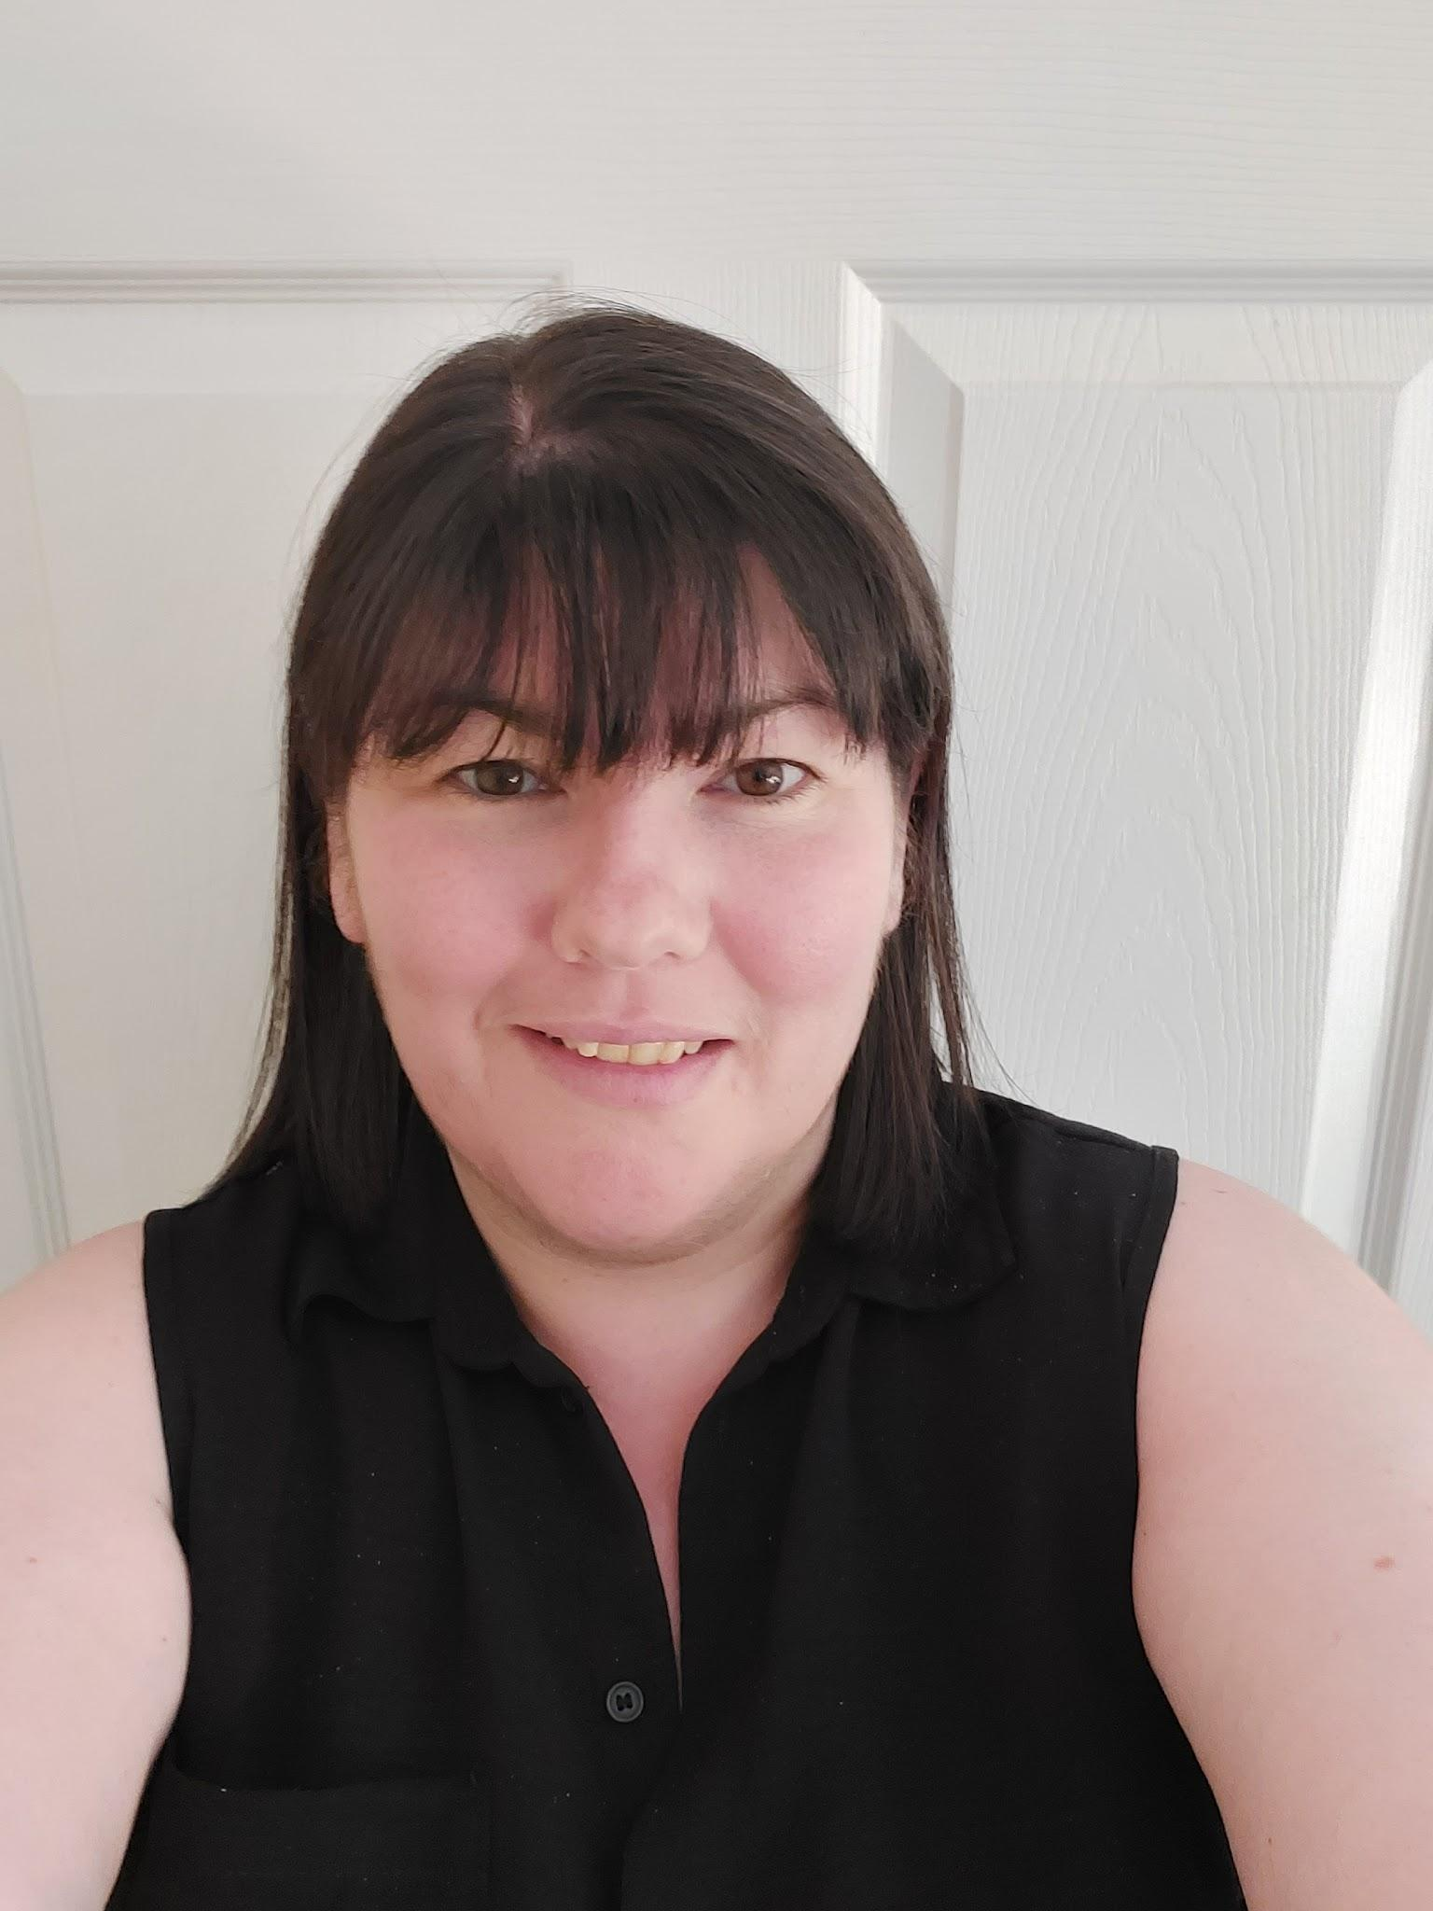
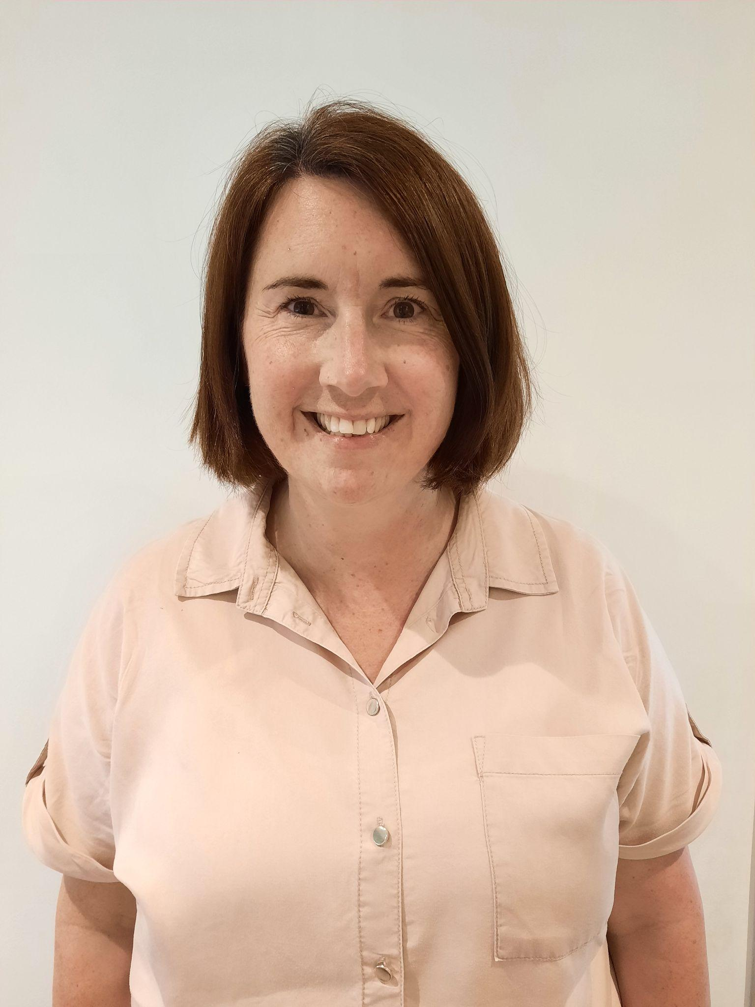
Principal Teacher Team
Lynsey Clements | Sarah Corrieri | Claire Mitchell | Joanna Hames

Slide 5
Burnbrae Vision
Our Vision
Burnbrae plays together, grows together, learns together
Children are encouraged to behave in a way which ensures every learner is Ready to learn, Respectful and Safe. Every class has a charter setting out the standards agreed and also a Board of Recognition to encourage children to aspire to be their best.
We are committed to working together with families and other agencies to ensure all learners can be all they can be.

Slide 6
Burnbrae Values

Slide 7
Virtual Tour
Virtual Tours for all Midlothian Schools
https://www.thinglink.com/card/1322124348550545410
Burnbrae Virtual Tour
https://burnbrae.mgfl.net/virtual-tour/
CN
https://www.thinglink.com/media/1587516109043531777

Slide 8
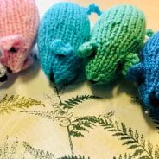
Burnbrae Website
We have a dedicated ELC – P1 transition page which, when the time comes, is updated weekly and includes the following:
Weekly Mid Mouse update
Transition letters
Virtual tour featuring videos from staff and pupils
Top tips for families
Link to the school handbook
Transition story list
Curriculum information
Transition visit dates - Families with a child joining Wee Brae our Complex Needs Provision will be contacted individually with further transition information
ELC – P1 Transition | Burnbrae Primary School (mgfl.net)

Slide 9
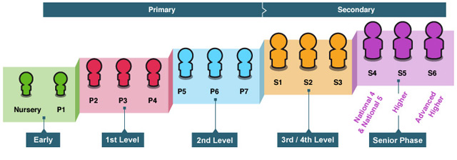
Further information can be found here -
Curriculum for Excellence in a Nutshell
Curriculum for Excellence
Scotland’s curriculum – Curriculum for Excellence (CfE) – helps our children and young people gain the knowledge, skills and attributes needed for life in the 21st century
Curriculum for Excellence places learners at the heart of education. At its centre are four fundamental capacities. These capacities reflect and recognise the lifelong nature of education and learning. The four capacities are aimed at helping children and young people to become:
Successful learners
Confident individuals
Responsible citizens
Effective contributors

Slide 10
Developing skills through play

Slide 11
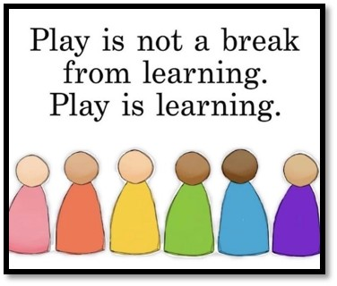
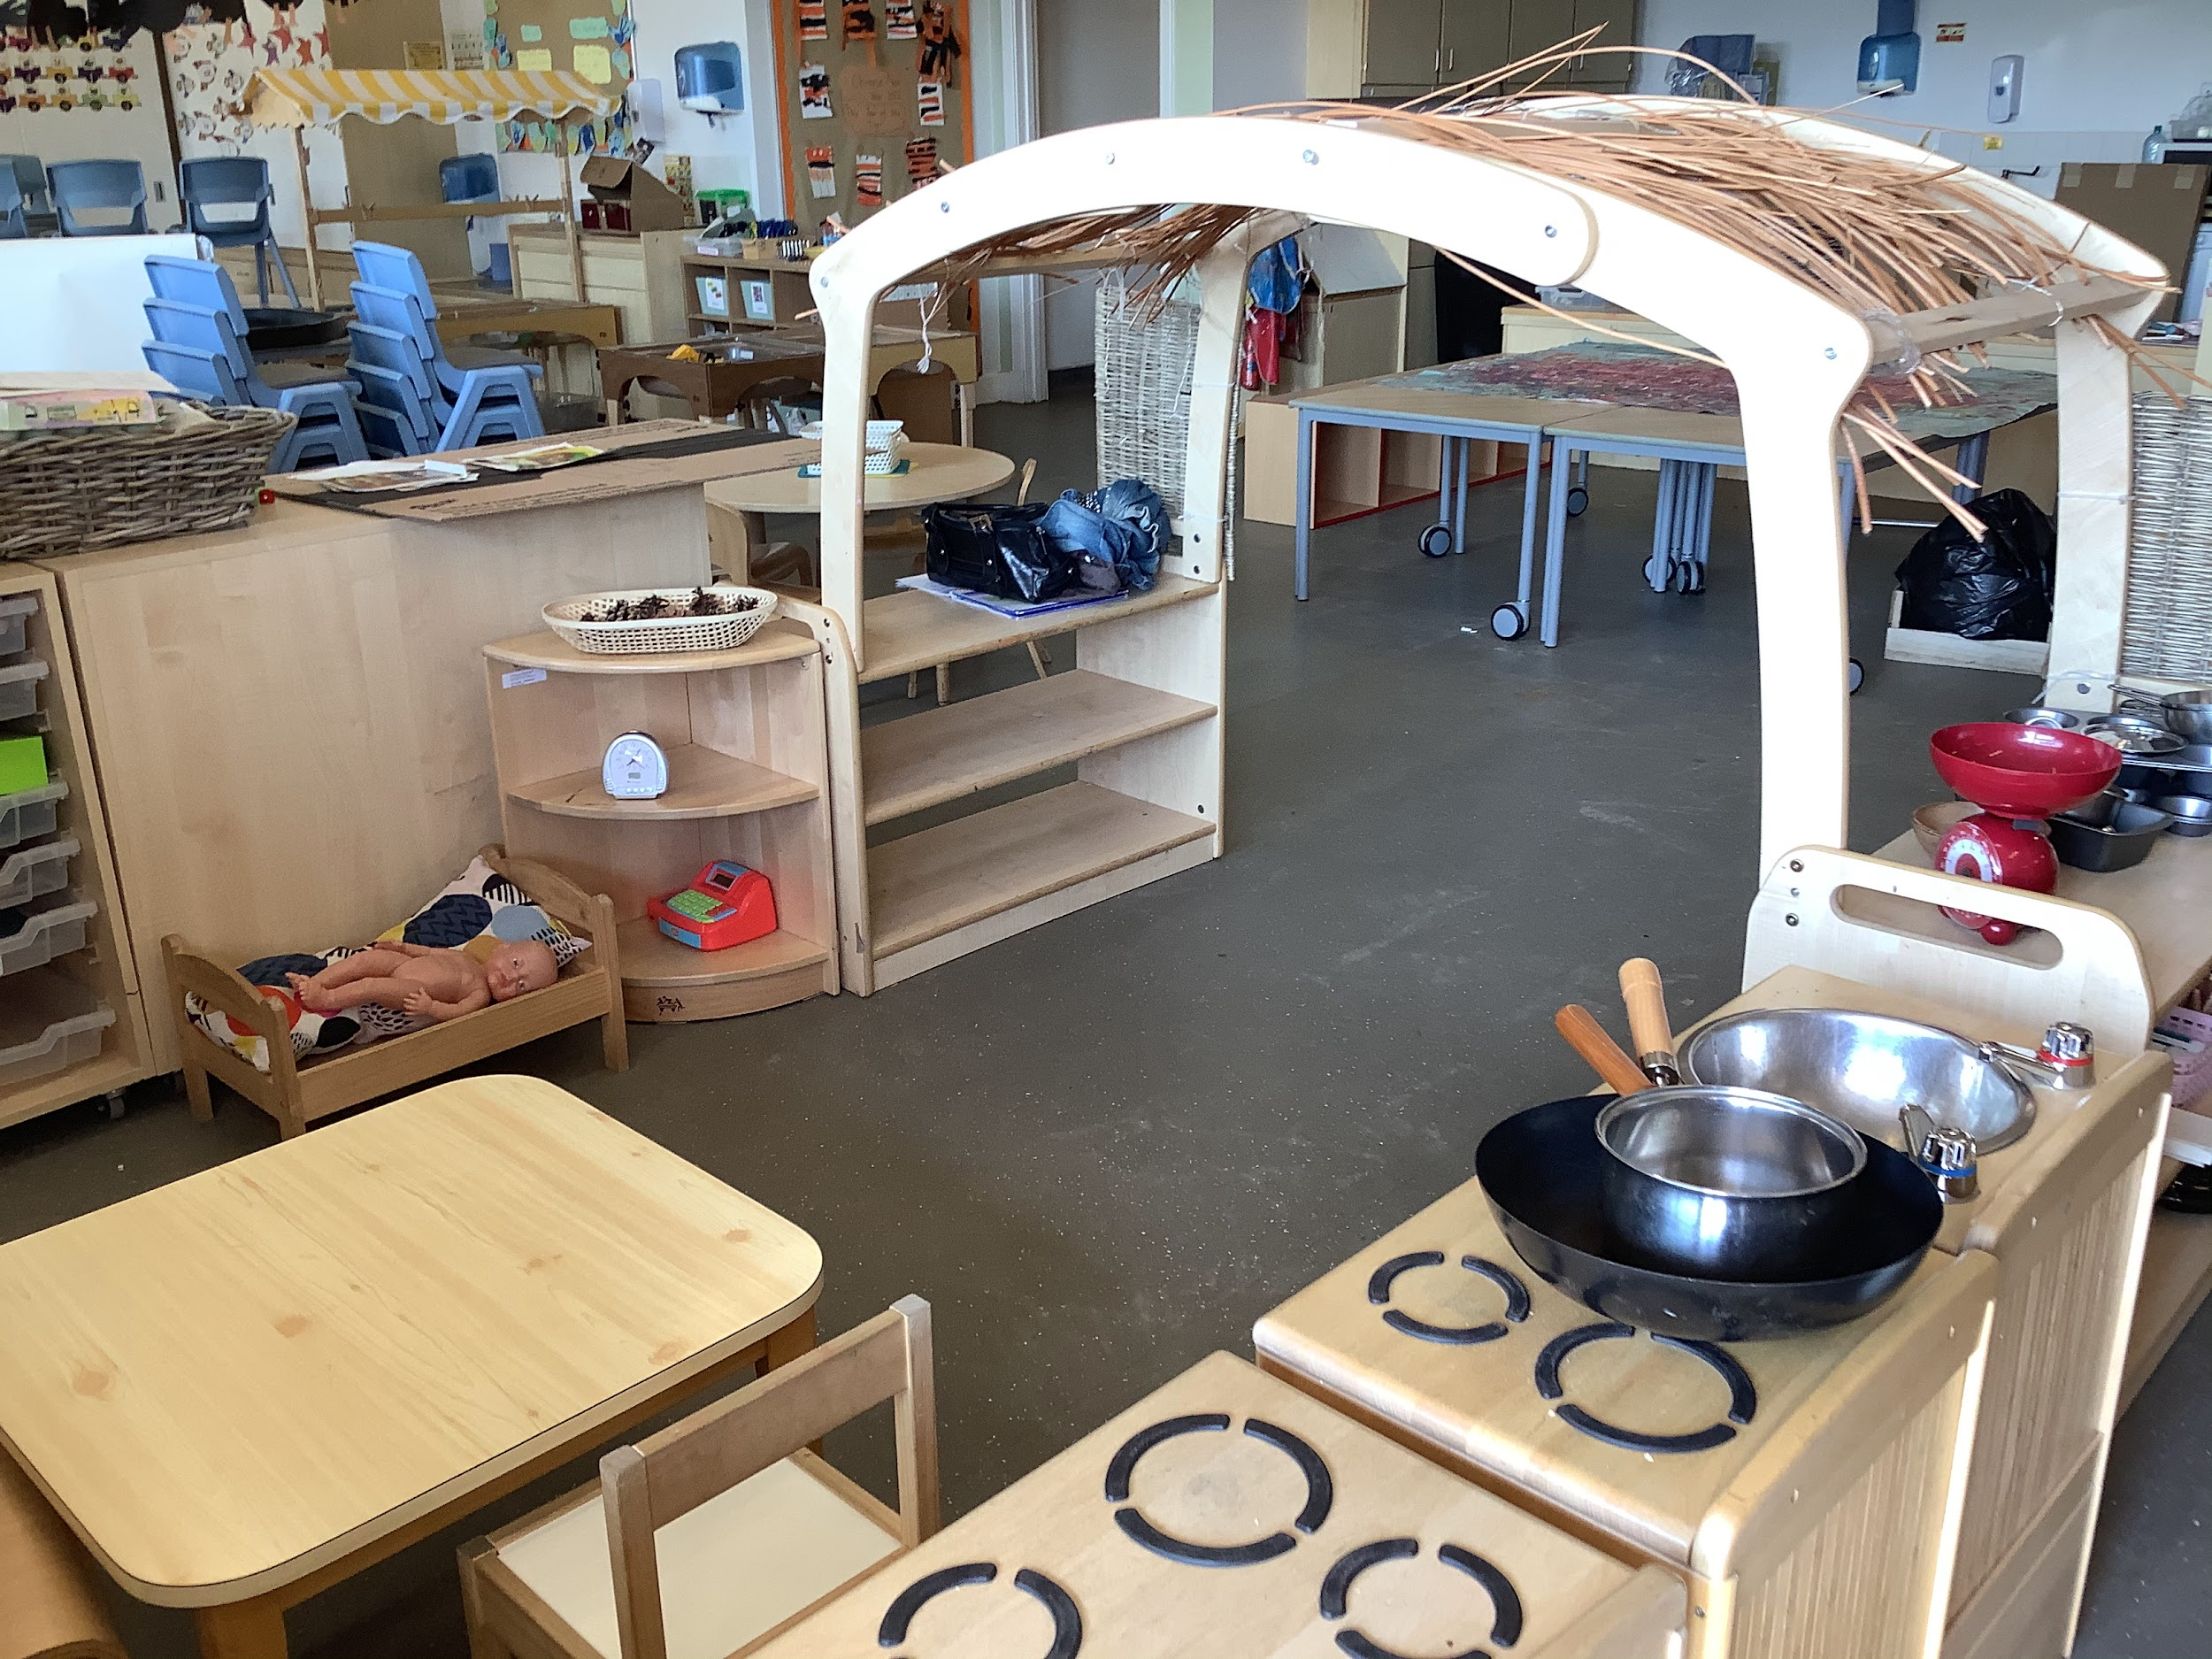
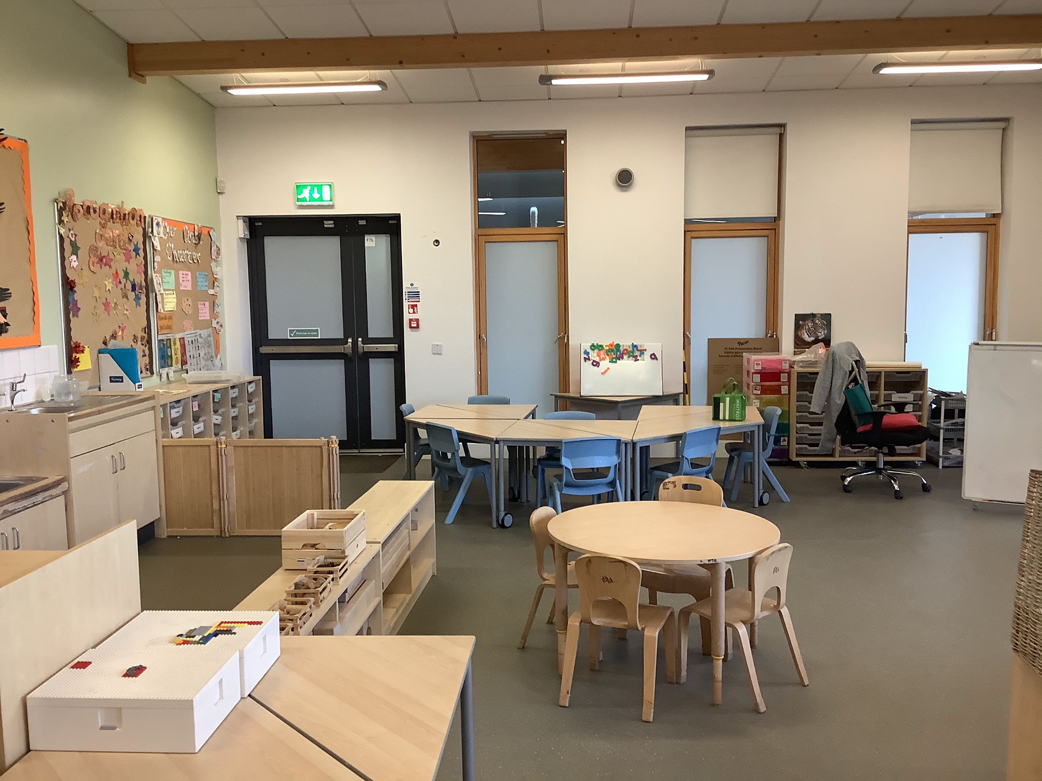
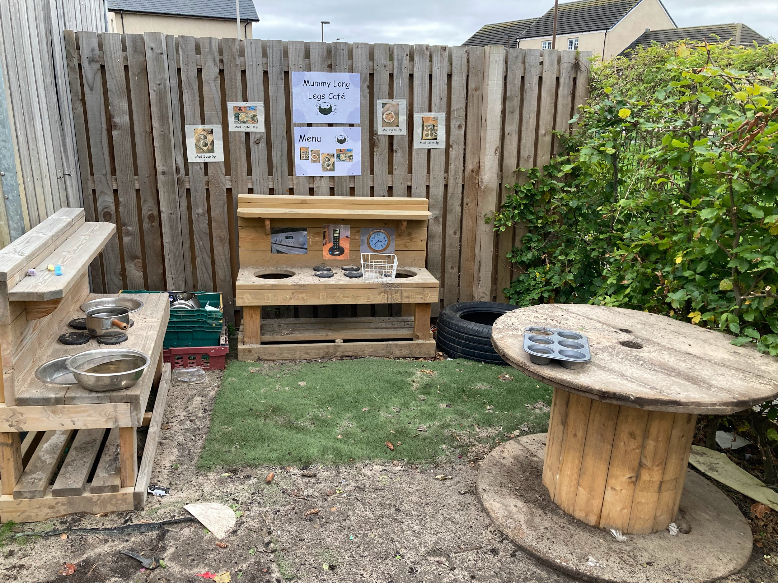
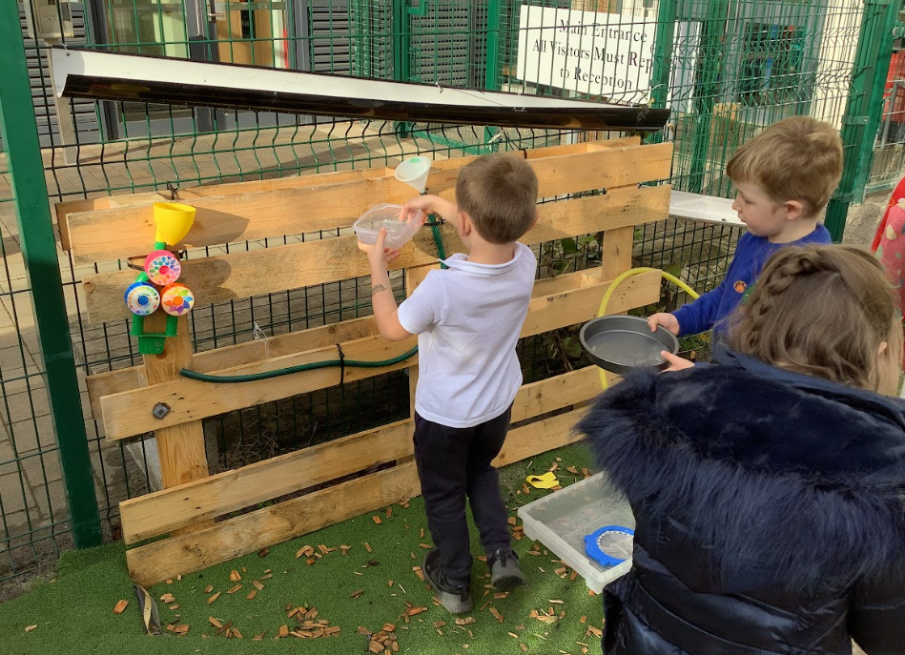
Our P1 Play Space
All classes play and learn together in our large play space. This will look a lot like nursery. We provide play opportunities to extend learning from nursery.

Slide 12
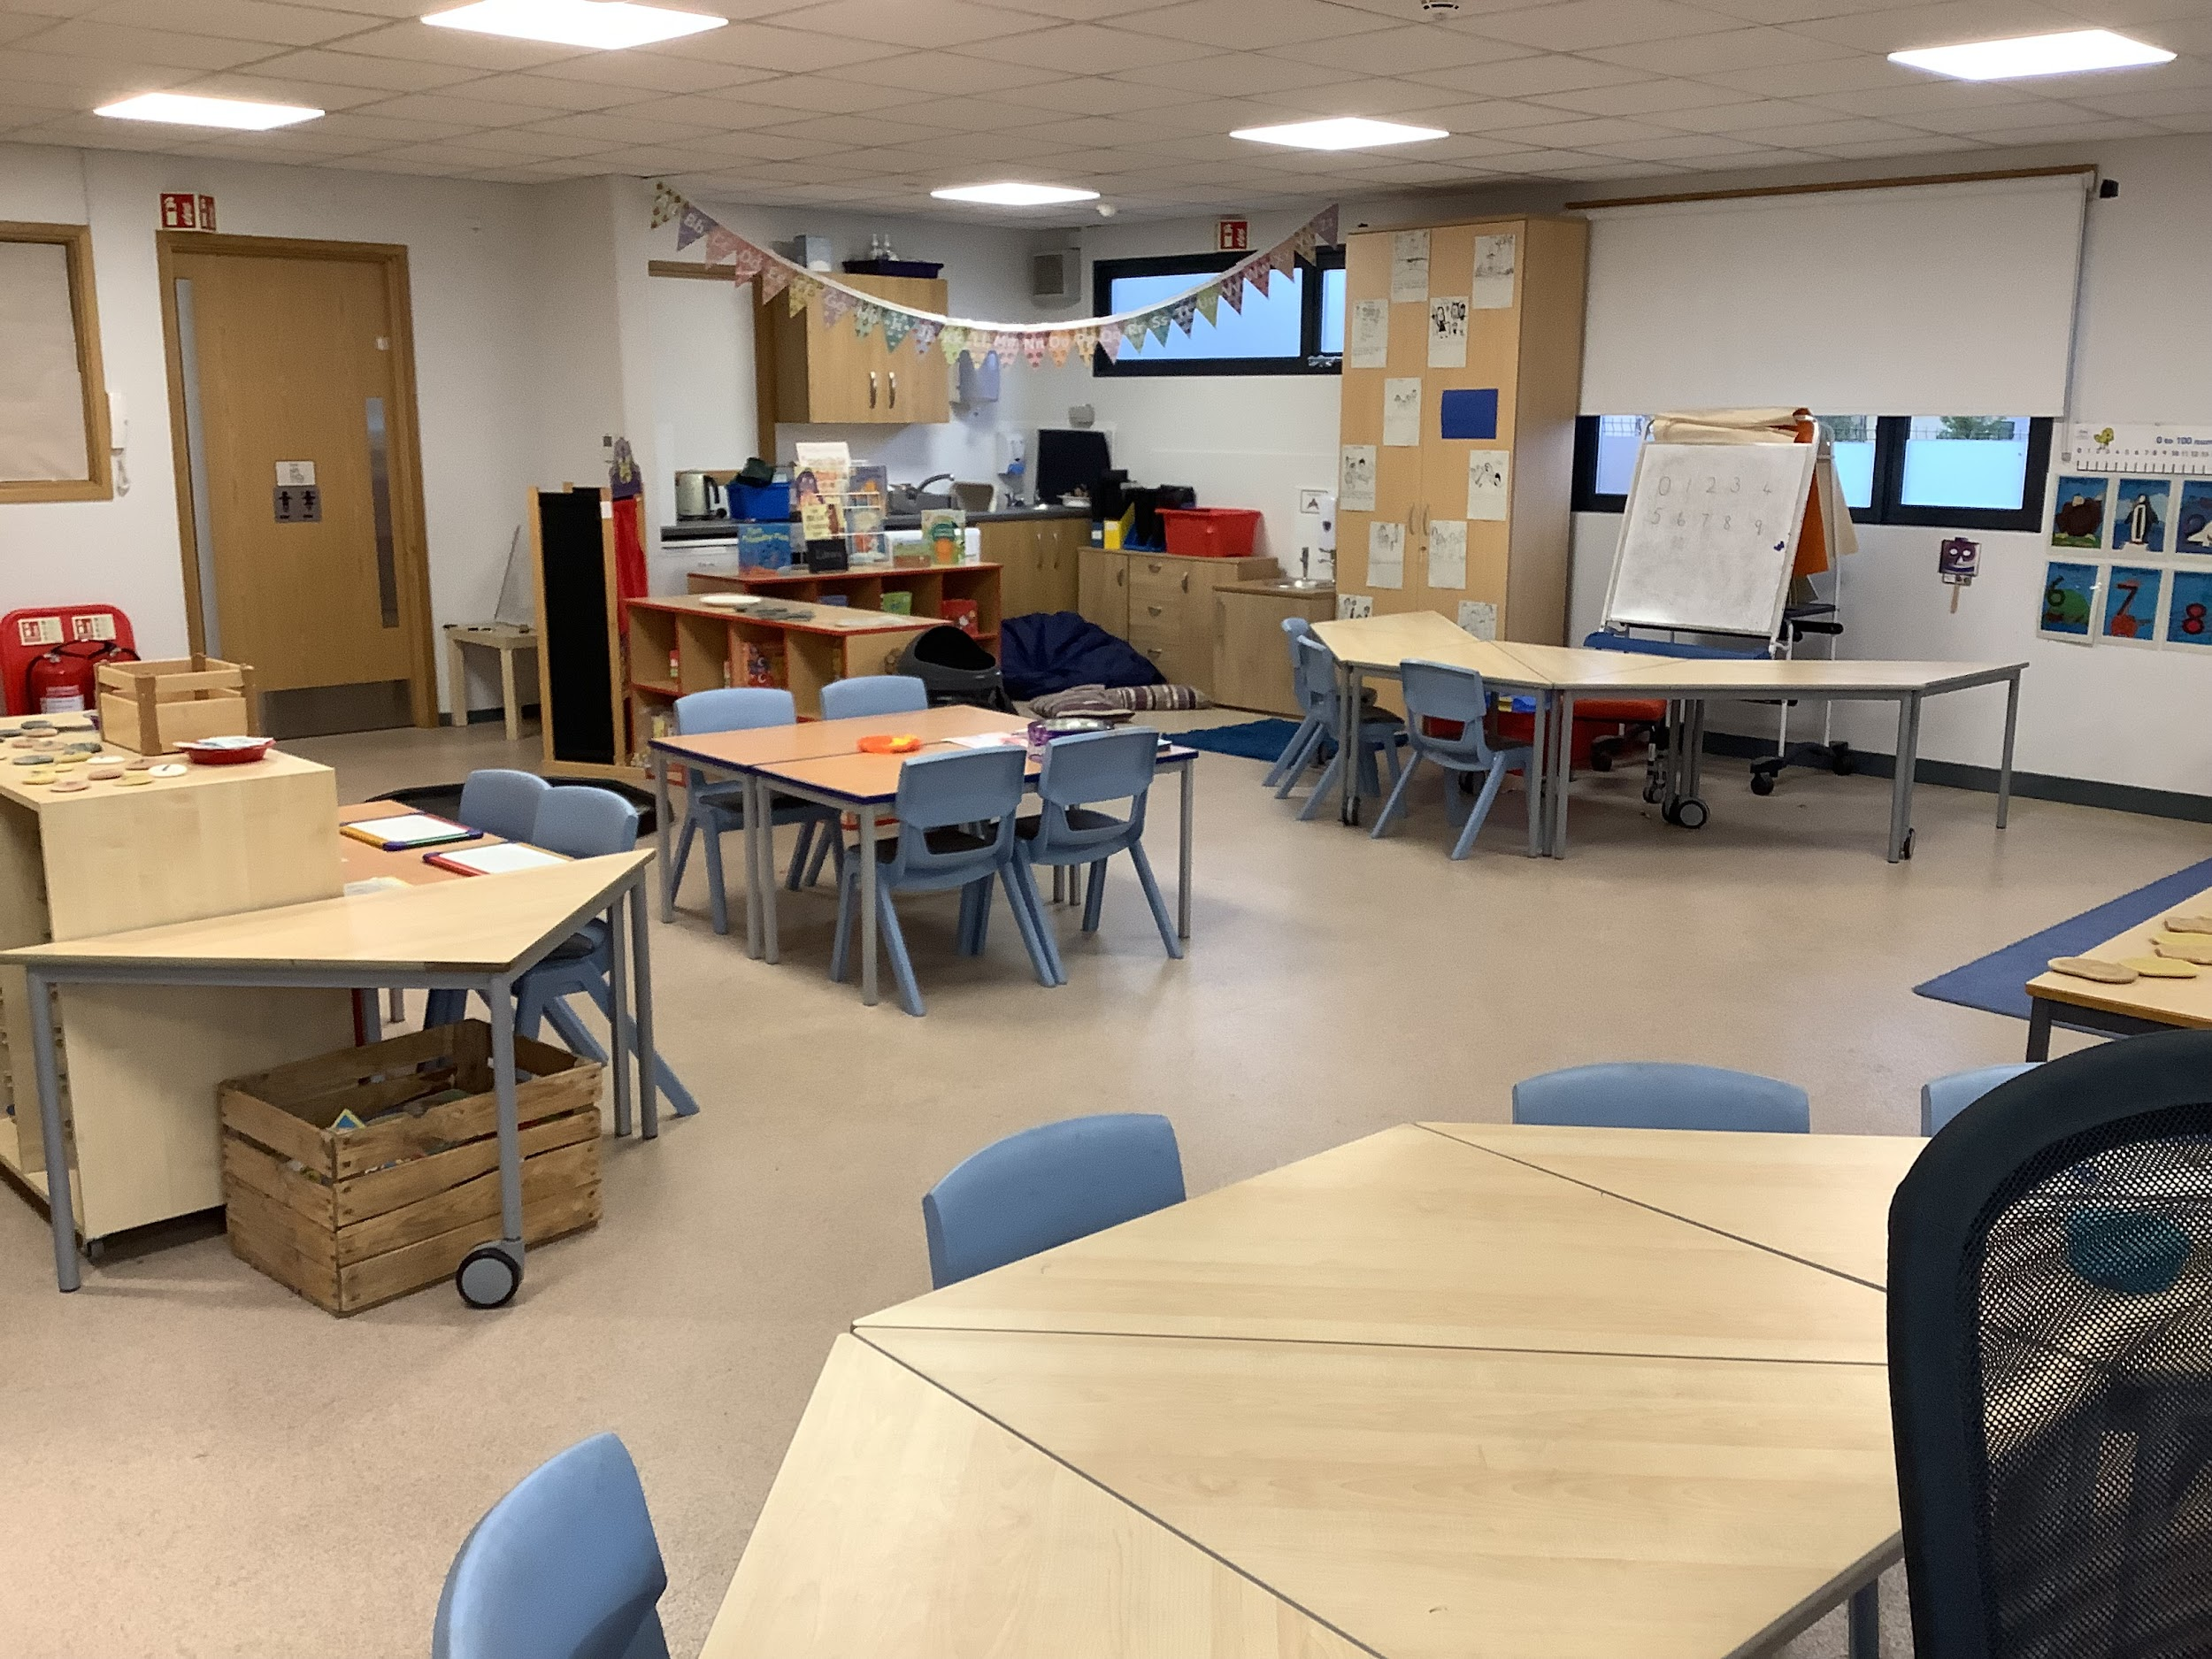
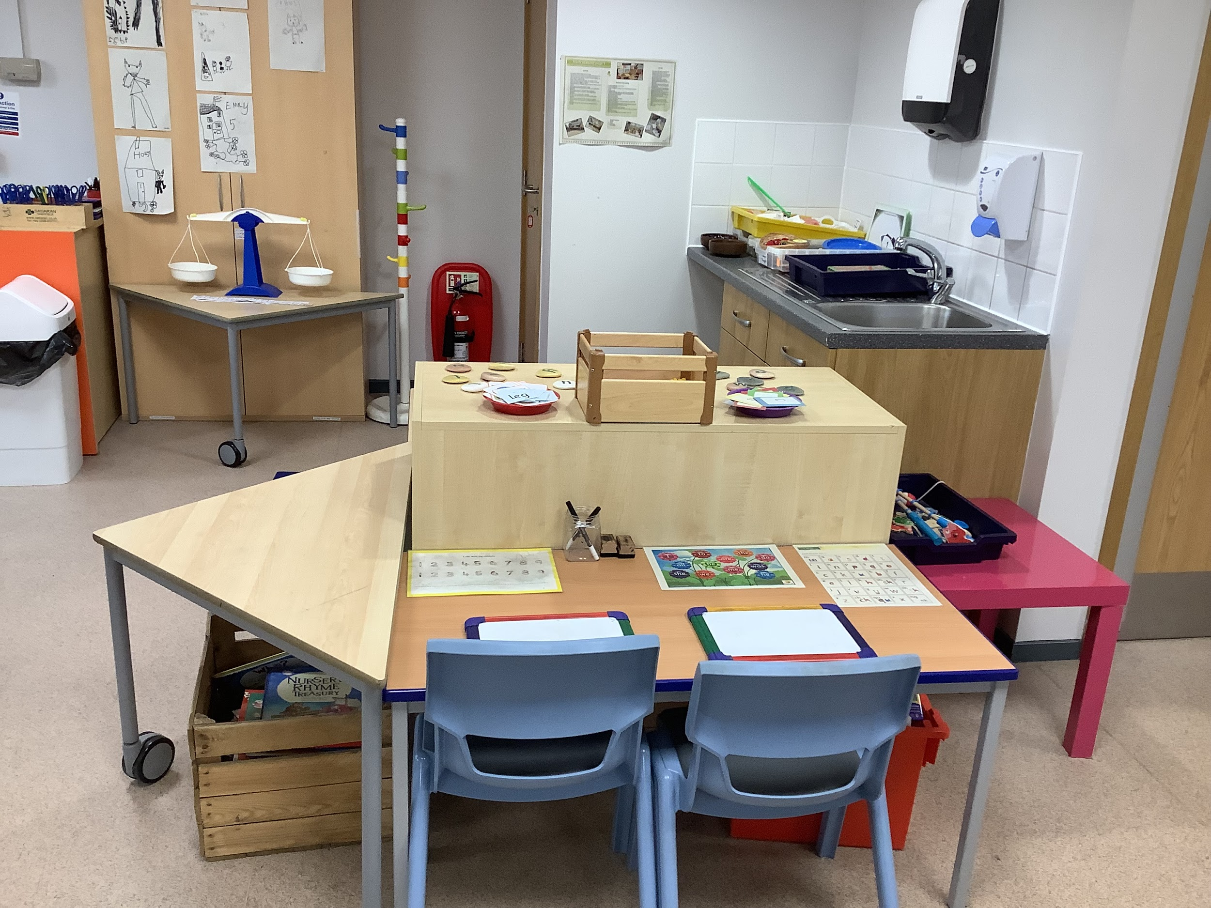
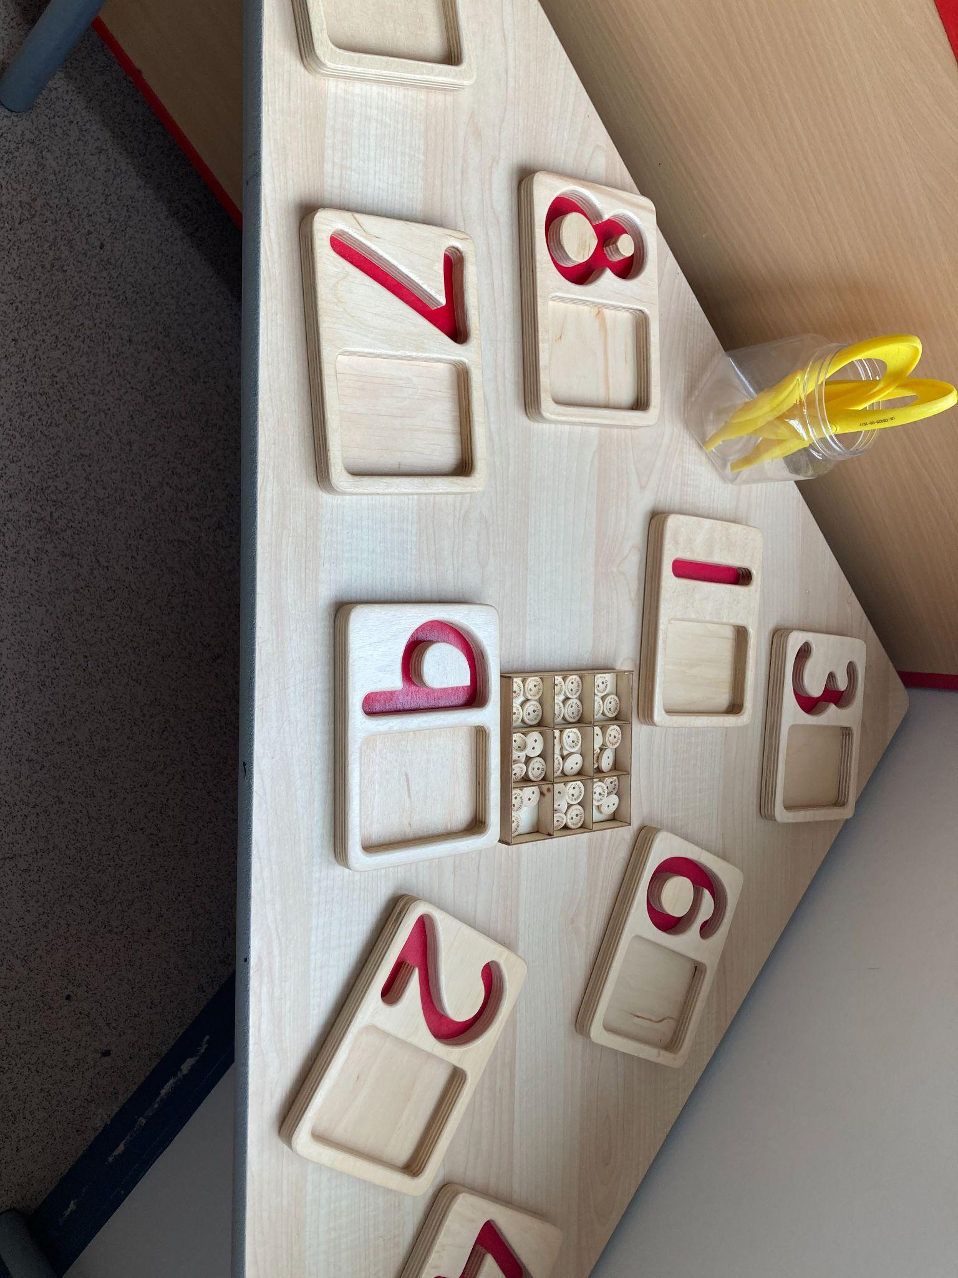
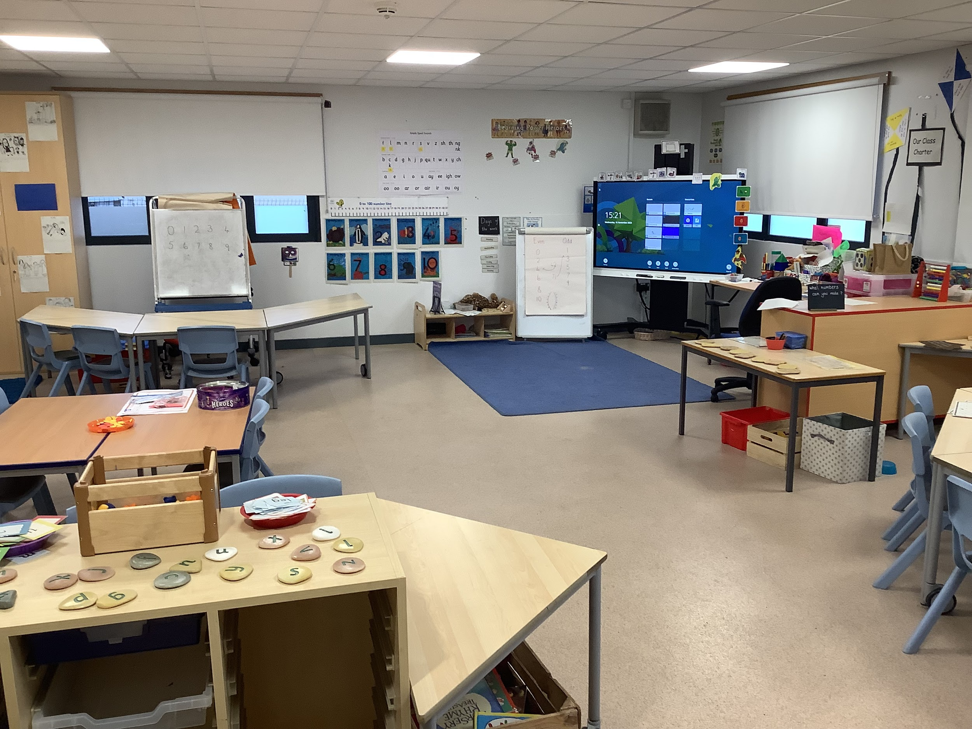
Our Learning in P1
As well as learning through our indoor and outdoor play, learning will also be through teacher initiated learning which can include Literacy and Numeracy activities as well as themed activities. These more formal teaching moments mostly happen in the cabin, our second learning space.

Slide 13
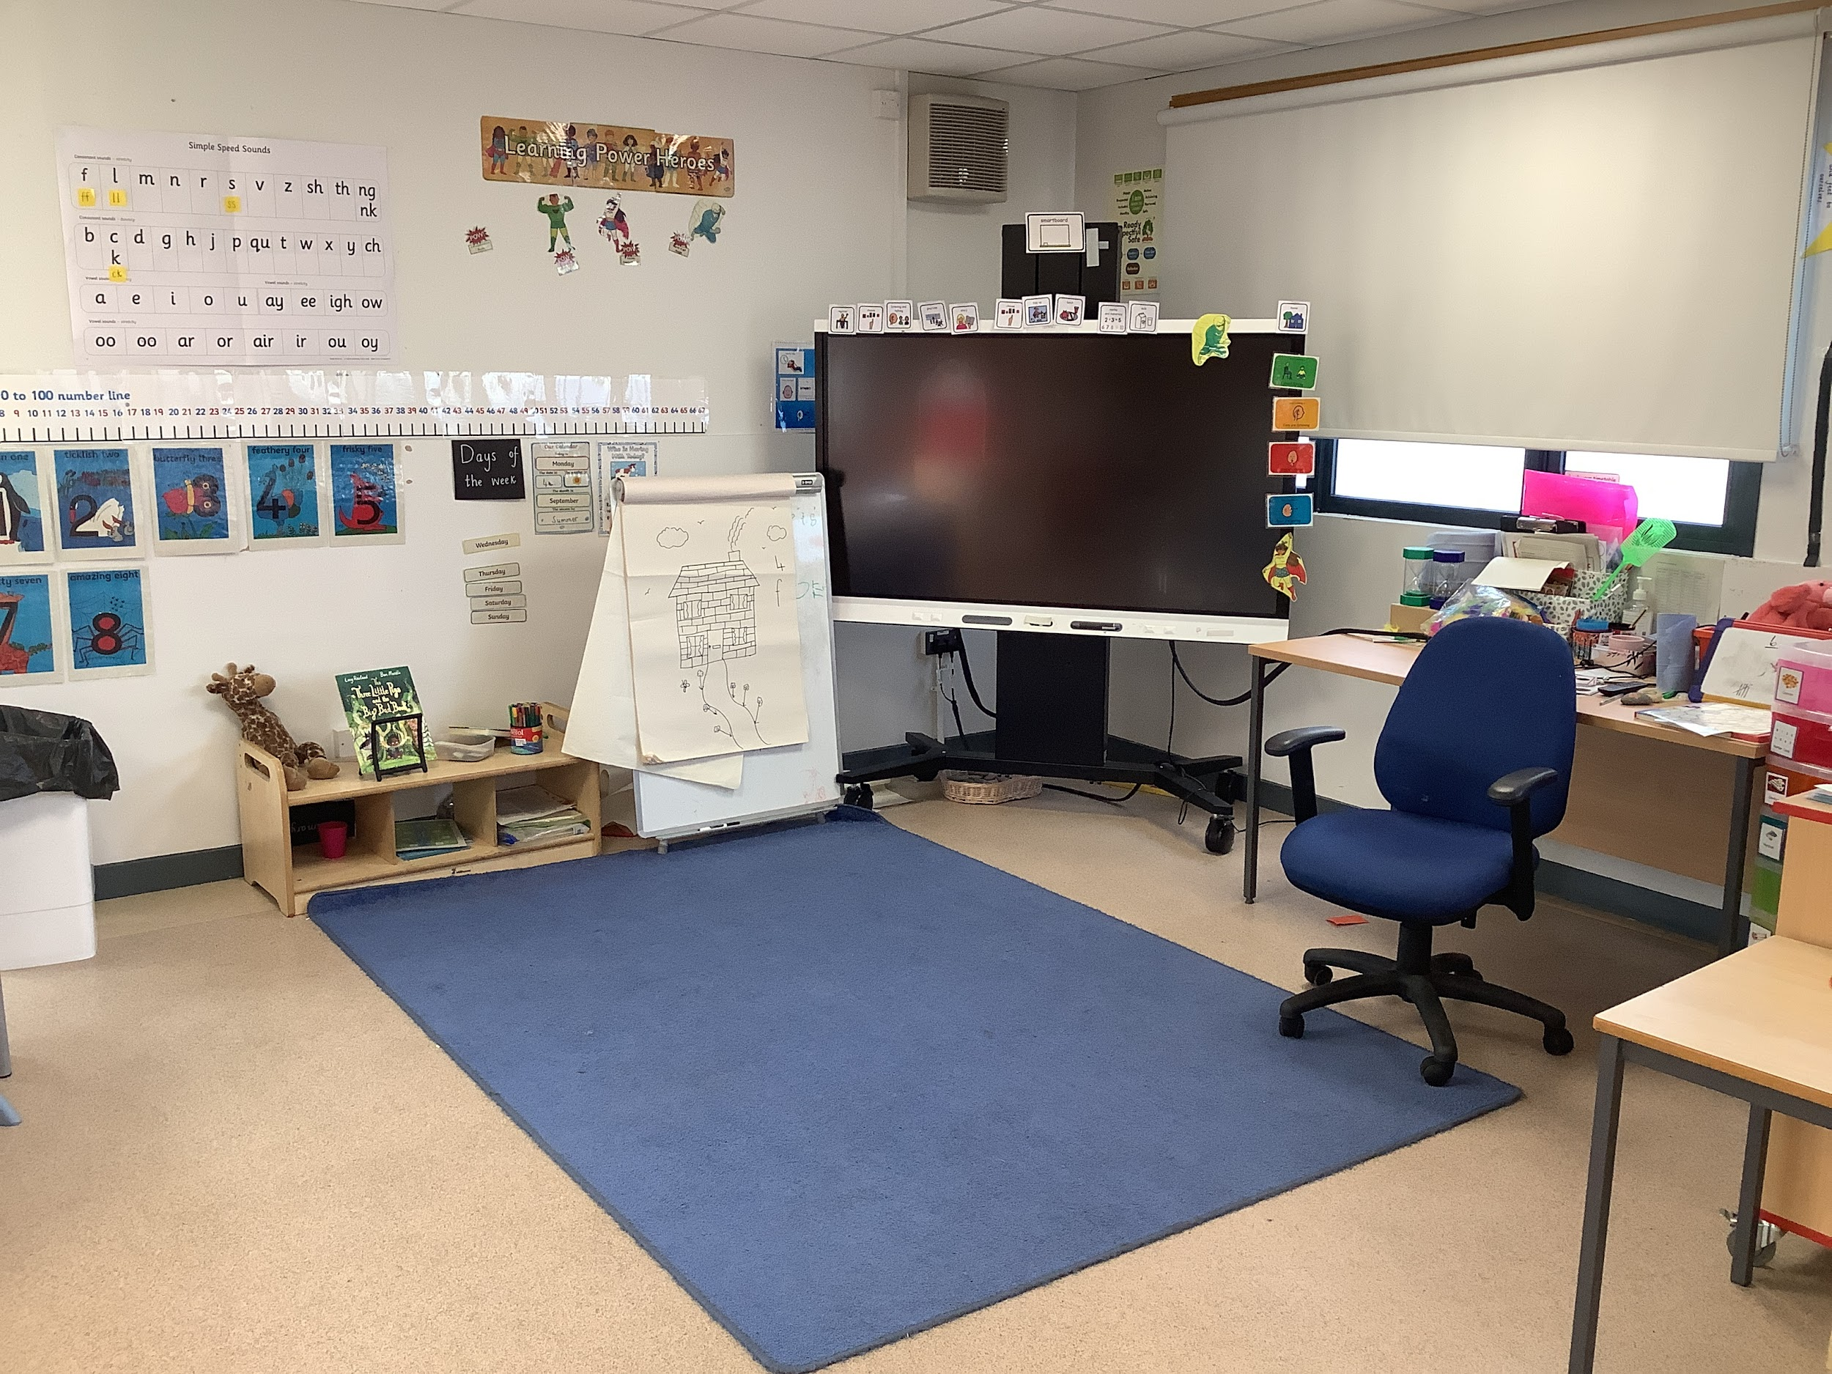
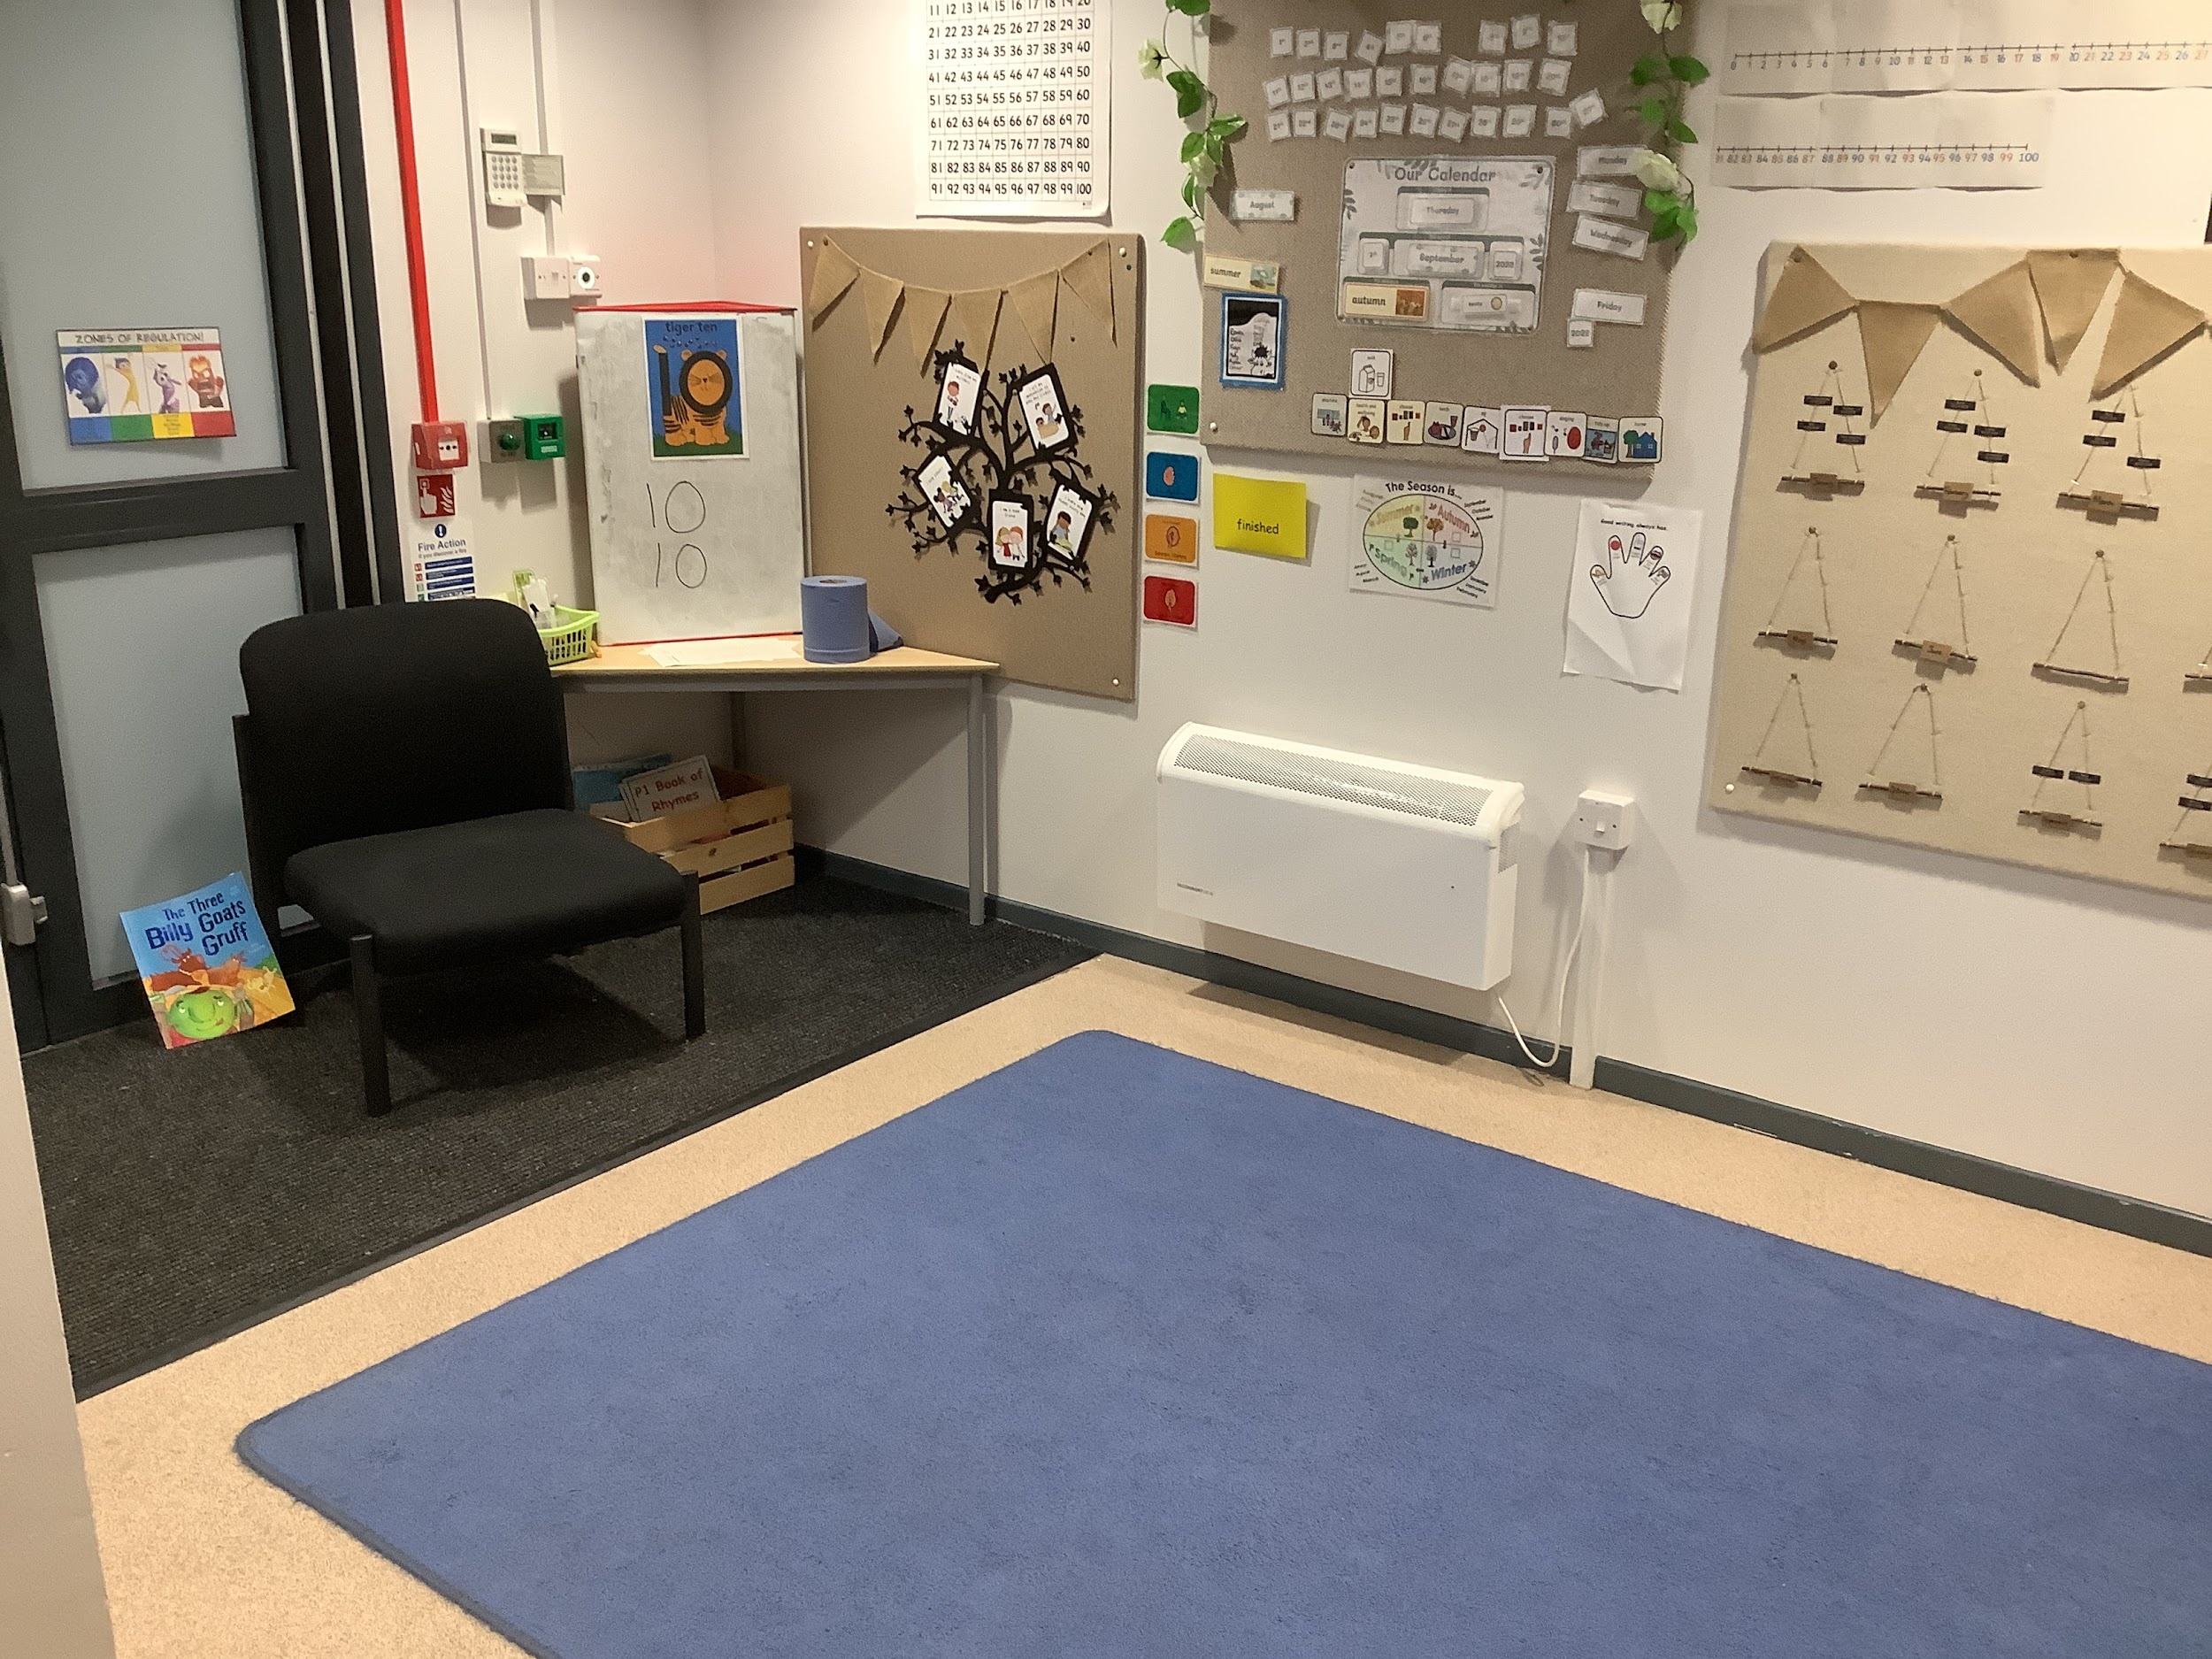
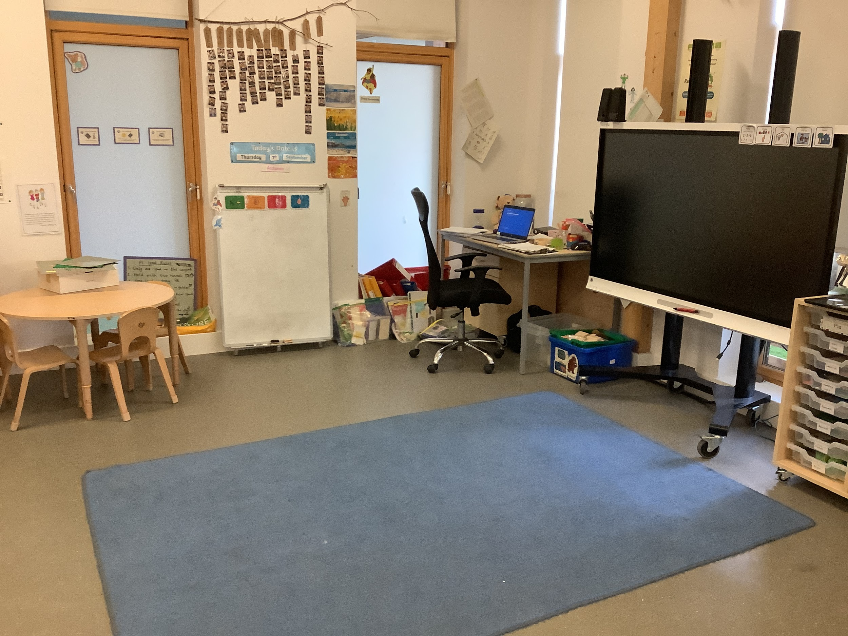
Our Gather Time
We meet regularly in our own class groups in our own gather spaces. In this time, we read stories, talk about how we are feeling, and have short direct teaching input. These times punctuate the day and allow children to connect with their teacher and the children in their class.

Slide 14
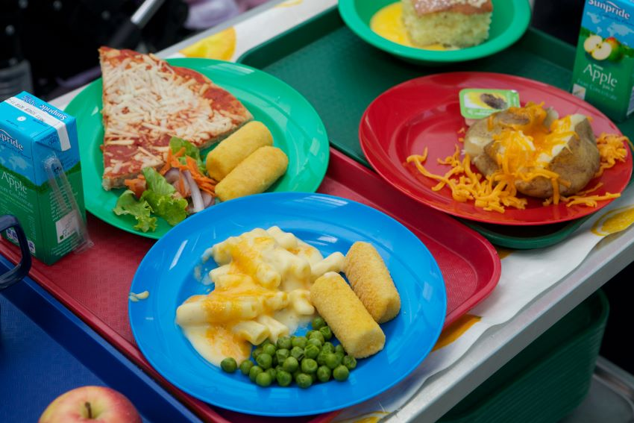
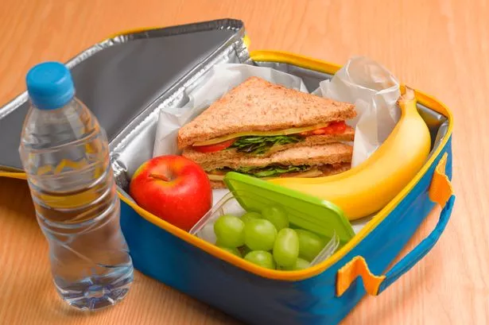
We use the ParentPay online payments system at Burnbrae Primary School, You can use ParentPay to pay securely online by debit or credit card. You can pay for a large range of school services and activities including trips, milk and school dinners. You will be given an activation letter when your child is fully enrolled into the school.
All P1-P5 children are entitled to a free school meal.
A meal costs £2.10 for P6 and P7.
We remind you that Burnbrae is a nut free school.
If you are eligible for or are in receipt of Free School Meals, Milk and Clothing grant, you should already have a form from Midlothian council to fill in and return to them. If you do not have this form please contact the school
https://www.midlothian.gov.uk/info/855/school_meals/13/school_lunches
https://www.midlothian.gov.uk/info/855/school_meals/117/free_school_meals_and_clothing_grants
Children can have milk daily. Milk is paid for on Parent Pay.
Notes:
Snack - Children need 1 healthy snack to eat at 10.15am
Water bottles - Children can access their water bottle throughout the day. We ask that only water is in this bottle.
Lunch - School lunches are free for P1-P5 however you can apply for ‘Free School Meals’ if you think you would be eligible for this. This will result in your children receiving free milk and you could be rewarded a clothing grant.
There is an additional ‘Best Start’ Grant which can also be applied for when children begin school.

Slide 15
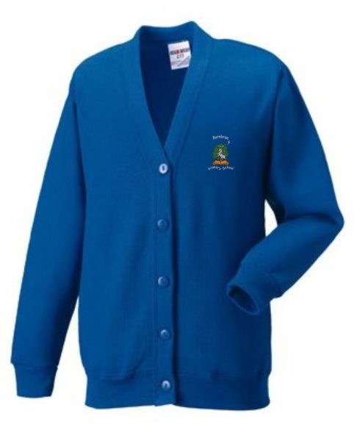
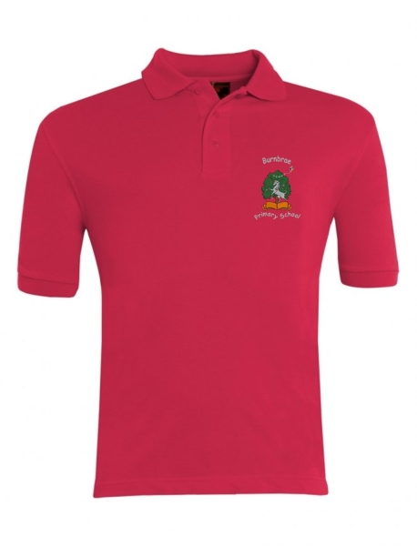
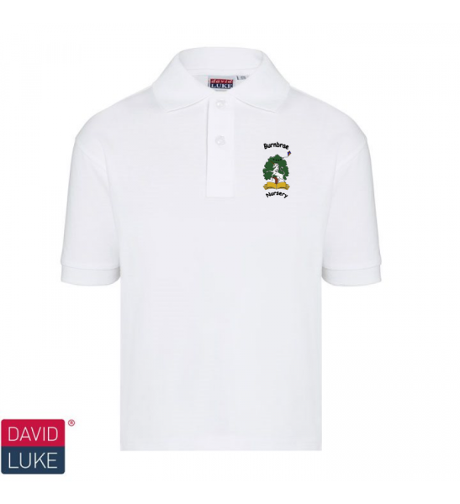
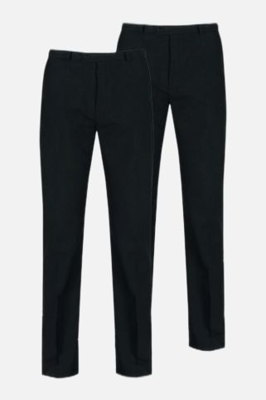
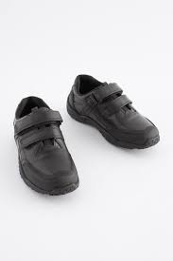
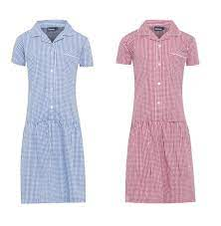
Uniform
Burnbrae Primary School uniform can be purchased from Border Embroideries via the online store – https://www.border-embroideries.co.uk/
Item | Colour | Colour P7
Sweatshirt/Cardigan | Royal Blue (P1-P6) | P7 Hoodies - Various Colours
Shirt Polo Shirt | White or Red | White or Red
Skirt, Trousers, Pinafore | Navy, Black or Grey | Navy , Black or Grey
School Dresses | Red or Blue Gingham
Joggers (No Logos) | Plain Black (P1-P7) | Grey (P7)
Leggings | Black | Black
Tie | Blue ,Black and White | Blue ,Black and White
Shoes/Trainers –No designer shoes please | Black | Black

Slide 16
The School Day
 | Monday- Thursday |  | Friday
Burnbrae Primary | 8:50 | 3:15 | 8:50 | 12:25
The Wee Brae | 8:50 - 9:00 | 3:00 | 9:00 | 12:00
P1 staff are always available in the morning and at pick up times for informal conversations and to pass on information.
Interval – 10.15 – 10.30 and 10.30 – 10.45
Lunch – 12.00 – 12.45 and 12.45 – 1.30

Slide 17
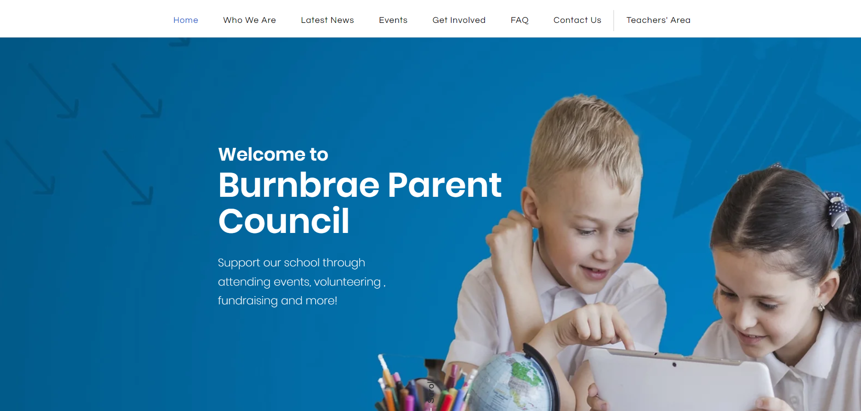
www.burnbraeparentcouncil.com

Slide 18
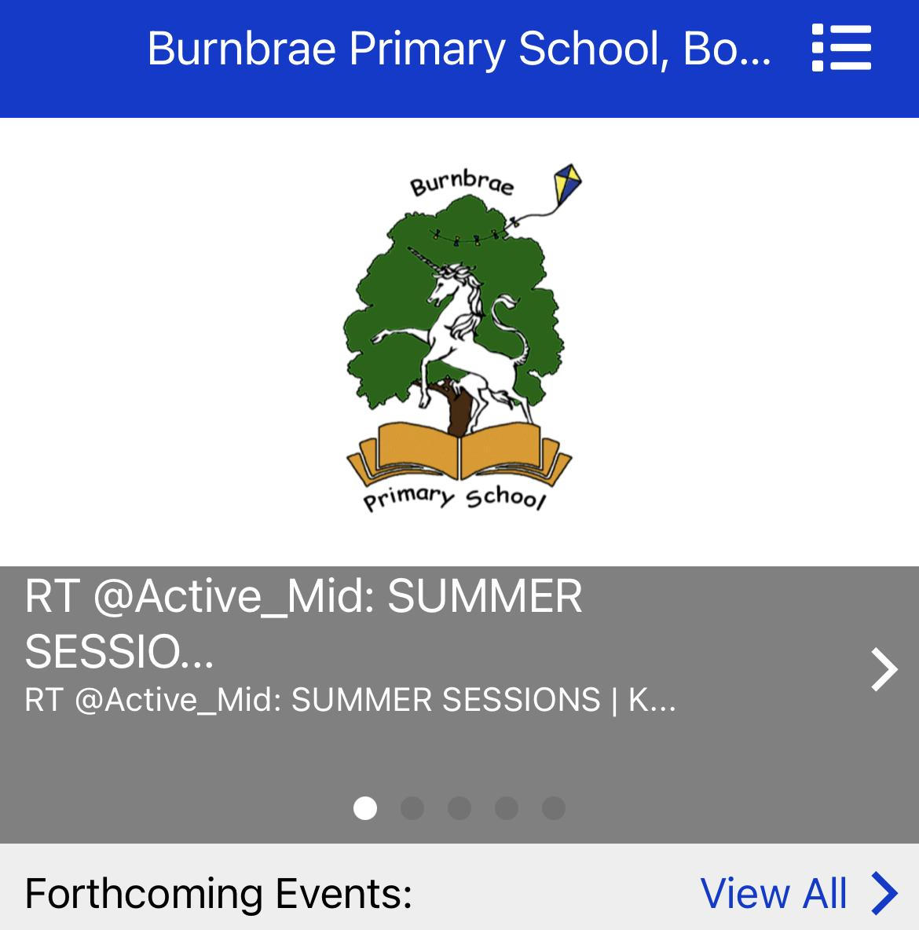
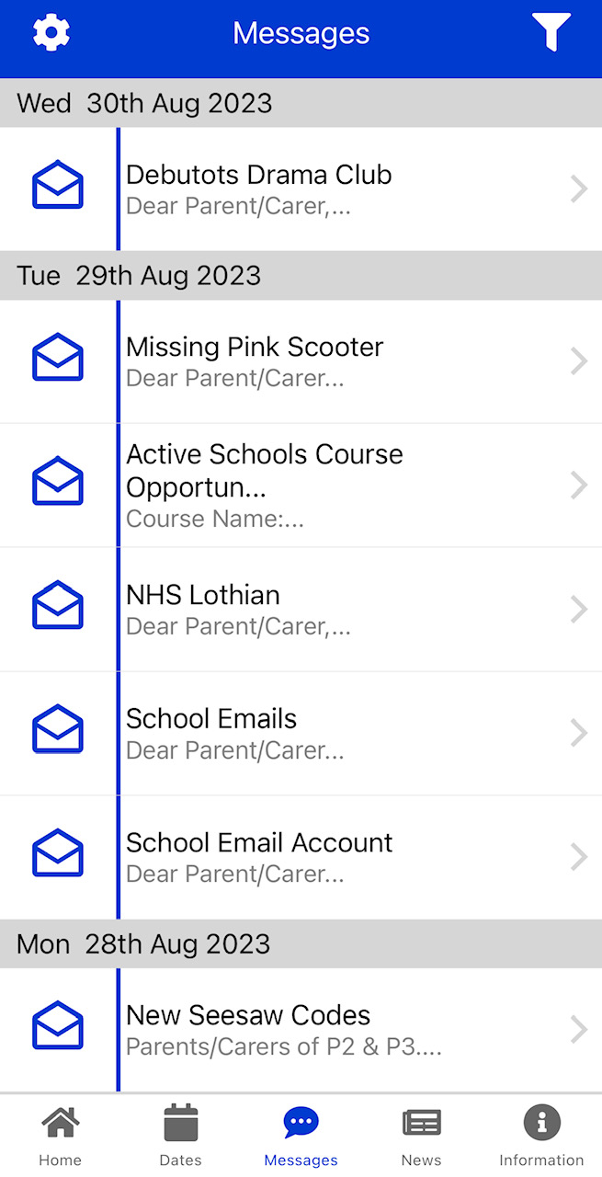
Keep in touch
The school App is our main platform for sharing school newsletters and information. Information will always be posted to the school app in the first instance. Please contact the school office if you require support to download the app. You can download a free copy of our school app from the android or apple app stores.
@Burnbraeps is our Twitter/X account where we post good news from around school.
Primary 1, 2 and 3 children will all have access to a Seesaw account.
All enquiries or appointments should be made through the school office.
Interval – 10.15 – 10.30 and 10.30 – 10.45
Lunch – 12.00 – 12.45 and 12.45 – 1.30

Slide 19
Interval – 10.15 – 10.30 and 10.30 – 10.45
Lunch – 12.00 – 12.45 and 12.45 – 1.30
Thank you. Please join us for a class tour. Our current Primary 1 staff will be available to answer any questions you might have.

